Slide 1
How to do econometric analysis with R or EViews ?
From ABC to applied projects

Slide 2


Outline
To set up R studio on your computer, download R from www.r-project.org and then download R studio from www.rstudio.com.
R or EViews
Step 1: Verify (6 pages)
Step 2: Test (12 pages)
To set up EViews on your computer, download EViews from http://vdisk.weibo.com/s/u9rU0430jx-Pc and then install following instructions from http://jingyan.baidu.com/article/20b68a88541919796cec6205.html.

Slide 3
Step 1: Verify conclusions using R
Thinking about linear regression models described in Chapters 2 and 3, our goal in this step is to change the assumptions and model form a little bit, then see what happens to: OLS estimate, mean of OLS estimate, estimate of variance of error, etc.
Let’s begin this query with the question: what if we…?
Violate Assumption MLR.4
Violate Assumption MLR.5
Omit the intercept
Omit one variable

Slide 4

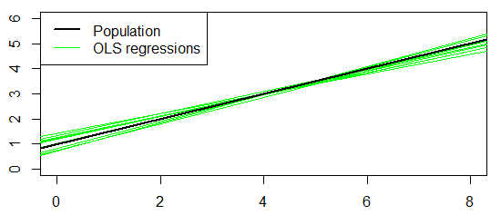
Monte Carlo Simulation with many samples
#set the random seed
set.seed(1234567)
#set sample size and number of simulations
n<-1000; r<-10000
#set true parameters: betas and sd of u
b0<-1; b1<-0.5; su<-2
#initialize b0hat and b1hat to store results later:
b0hat<-numeric(r)
b1hat<-numeric(r)
#Draw a sample of x, fixed over replications:
x<- rnorm(n,4,1)
#repeat r times:
for (j in 1:r){
#Draw a sample of y:
u<- rnorm(n,0,su)
y<- b0 + b1*x + u
#estimate parameters by OLS and store them in the vectors
bhat <- coefficients(lm(y~x))
b0hat[j] <- bhat["(Intercept)"]
b1hat[j] <- bhat["x"]
}
#Initialize empty plot
plot(NULL,xlim=c(0,8),ylim=c(0,6),xlab="x",ylab="y")
#add OLS regression lines
for (j in 1:10) abline(b0hat[j],b1hat[j],col="green")
#add population regression line
abline(b0,b1,lwd=2)
#add legend
legend("topleft",c("Population","OLS regressions"),
lwd=c(2,1),col=c("black","green"))

Slide 5



Monte Carlo Simulation: Violation of MLR.4 with k=2 explanatory variables
# Set the random seed
set.seed(1234567)
# set sample size and number of simulations
n<-1000; r<-1000
# set true parameters: betas and sd of u
b0<-0.5; b1<-1; b2<-2; su<-2
# initialize b0hat to b2hat to store results later
b0hat<-numeric(r)
b1hat<-numeric(r)
b2hat<-numeric(r)
# Draw a sample of x1 and x2, fixed over replications:
x1<- rnorm(n,4,1)
x2<- rnorm(n,0.5,5)
# repeat r times:
for(j in 1:r){
# Draw a sample of y:
u<- rnorm(n,x1/x2,su)
y<- b0+b1*x1+b2*x2+u
# estimate parameters by OLS and store them in the vectors
bhat <- coefficients(lm(y~x1+x2))
b0hat[j]<-bhat["(Intercept)"]
b1hat[j]<-bhat["x1"]
b2hat[j]<-bhat["x2"]
}
# t statistic of the MC estimate
(mean(b0hat)-b0)/sqrt(var(b0hat)/(r-1))
(mean(b1hat)-b1)/sqrt(var(b1hat)/(r-1))
(mean(b2hat)-b2)/sqrt(var(b2hat)/(r-1))

Slide 6





Monte Carlo Simulation: Violation of MLR.5 with k=2 explanatory variables
# Set the random seed
set.seed(1234567)
# set sample size and number of simulations
n<-1000; r<-10000
# set true parameters: betas and sd of u
b0<-0.5; b1<-1; b2<-2; su<-2
# initialize b0hat to b2hat to store results later
b0hat<-numeric(r)
b1hat<-numeric(r)
b2hat<-numeric(r)
vuhat<-numeric(r)
# Draw a sample of x1 and x2, fixed over replications:
x1<- rnorm(n,4,1)
x2<- runif(n,3,7)
# repeat r times:
for(j in 1:r){
# Draw a sample of y:
u<- sqrt(x2)*rnorm(n,0,su)
y<- b0+b1*x1+b2*x2+u
Estimate of
# estimate parameters by OLS and store them in the vectors
bhat <- coefficients(lm(y~x1+x2))
b0hat[j]<-bhat["(Intercept)"]
b1hat[j]<-bhat["x1"]
b2hat[j]<-bhat["x2"]
vuhat[j]<-(sigma(lm(y~x1+x2)))^2
}
# t statistic of the MC estimate
(mean(b0hat)-b0)/sqrt(var(b0hat))
(mean(b1hat)-b1)/sqrt(var(b1hat))
(mean(b2hat)-b2)/sqrt(var(b2hat))
# MC estimate of variance of error term
mean(vuhat)

Slide 7






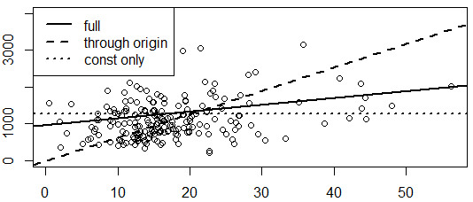
Regression through the origin and regression on a constant: Example 2.3
library(foreign)
ceosall<-read.dta("http://fmwww.bc.edu/ec-p/data/wooldridge/ceosal1.dta")
# Usual OLS regression:
(reg1 <- lm( salary ~ roe, data=ceosall))
# Regression without intercept (through origin):
(reg2 <- lm( salary ~ 0 + roe, data=ceosall))
# Regression without slope (on a constant):
(reg3 <- lm( salary ~ 1, data=ceosall))
# average y:
mean(ceosall$salary)
# Scatter Plot with all 3 regression lines
plot(ceosall$roe, ceosall$salary, ylim=c(0,4000))
abline(reg1, lwd=2, lty=1)
abline(reg2, lwd=2, lty=2)
abline(reg3, lwd=2, lty=3)
legend("topleft",c("full","through origin","const only"),lwd=2,lty=1:3)
Notes:
Useful reference: see R Stats Package in help

Slide 8






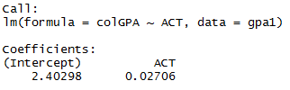
Omitted Variable Bias : Verify [3.23]
library(foreign)
gpa1<-read.dta("http://fmwww.bc.edu/ec-p/data/wooldridge/gpa1.dta")
# Parameter estimates for full and simple model:
beta.hat <- coef ( lm(colGPA ~ ACT+hsGPA, data = gpa1) )
beta.hat
# Relation between regressors:
delta.tilde <- coef( lm(hsGPA ~ ACT, data=gpa1) )
delta.tilde
# Omitted variables formula for beta1.tilde:
beta.hat["ACT"] + beta.hat["hsGPA"]*delta.tilde["ACT"]
# Actual regression with hsGPA omitted:
lm(colGPA ~ ACT, data=gpa1)

Slide 9
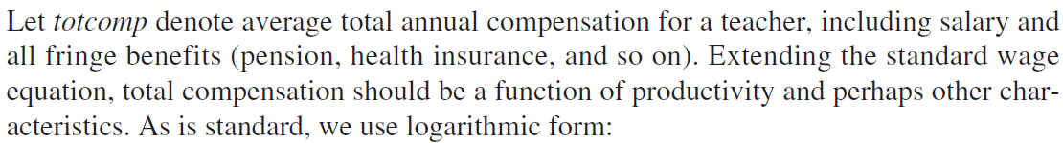


Slide 10
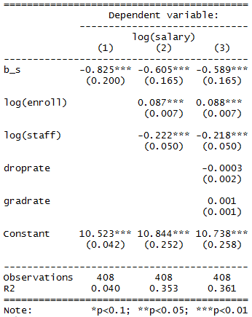

Reporting Regression Results: Generate Table 4.1 in Example 4.10
library(foreign)
meap93<-read.dta("http://fmwww.bc.edu/ec-p/data/wooldridge/meap93.dta")
# define new variable within data frame
meap93$b_s <- meap93$benefits / meap93$salary
# Estimate three different models
model1<- lm(log(salary) ~ b_s,
data = meap93)
model2<- lm(log(salary) ~ b_s+log(enroll)+log(staff),
data = meap93)
model3<- lm(log(salary) ~ b_s+log(enroll)+log(staff)
+droprate+gradrate,
data=meap93)
# Load package and display table of results
install.packages("stargazer")
library(stargazer)
stargazer(list(model1,model2,model3),type="text",
keep.stat=c("n","rsq"))
# F test
library(car)
myH0<- c("droprate","gradrate")
linearHypothesis(model3, myH0)

Slide 11
Step 2: Test Hypotheses using EViews
Thinking about hypothesis testing described in Chapter 4, our goal in this step is to carry out the tests using EViews after we have estimated a linear model under Classical Linear Model assumptions.
Under assumption MLR. 6 , we conduct several tests …
t test
F test
test with linear restriction
test with nonlinear restriction
Notes:
Useful reference: Eviews( Users Guide II Chapter 1 Basic Equation Analysis ) P64 Users Guide I (Creating a Workfile by Reading from a Foreign Data Source)

Slide 12
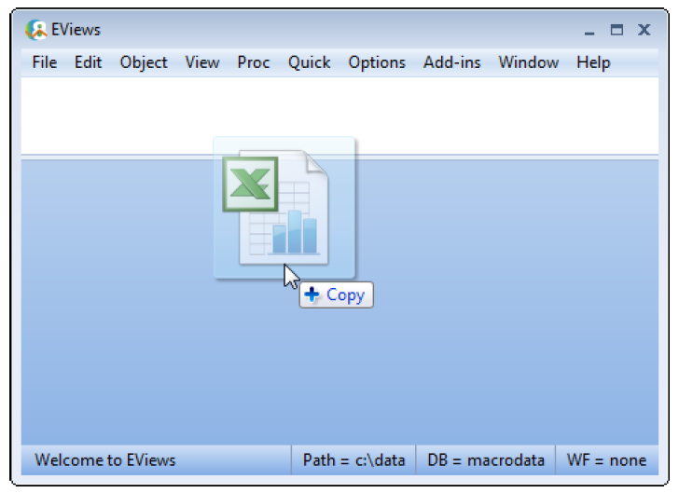
Example 2.4, 2.10, and 4.1 using the data in WAGE1.RAW
Step1: Import Data
Drag-and-drop the file WAGE1.xlsx into background area of the main EViews window

Slide 13
Example 2.4: Wage and Education
Step 2: Specify an Equation
Option 1: Specify an equation by list
First, highlight the dependent variable in the workfile window by single clicking on the entry. Next, CTRL-click all of your variables, right click and select Open/as Equation… .
Option 2: Specify an equation by formula
First, select Quick/Estimate Equation… from the main menu, or simply type the keyword equation in the command window. Next, specify your equation by formula in the Equation Specification dialogue box that appears, and select an estimation method.

Slide 14
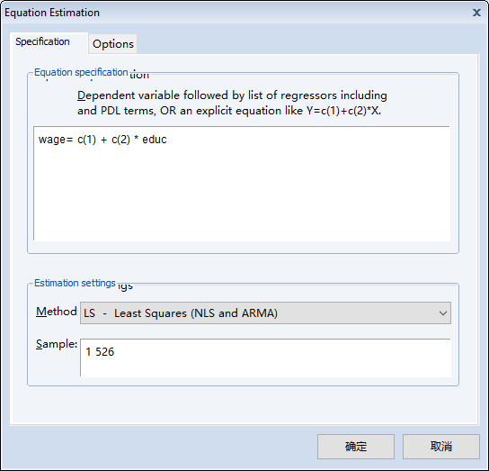

Example 2.4: Wage and Education
Option 2: Specify an equation by formula
Finally, use the default coefficient vector C, a pre-defined object in your workfile, to denote the kth coefficient by C(k) and enter the equation.

Slide 15


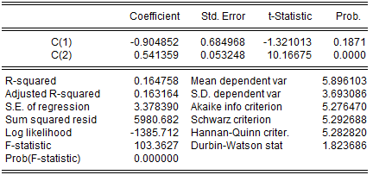




Example 2.4: Wage and Education
Step 3: Display the Estimation Output View
Notes:
Select all in the view and right click, select edit +/- to change output

Slide 16
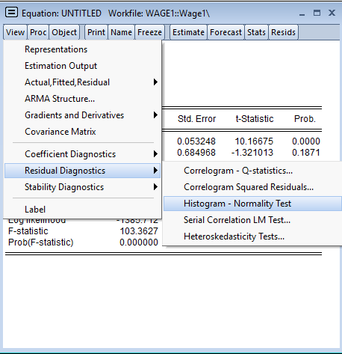
Example 2.4: Wage and Education
Step 4: Use residual diagnostics to test normality of residuals
To display a histogram and descriptive statistics of the residuals, select View/Residual Diagnostics/Histogram-Normality Test.
Notes:
Enter page 175 in the pdf file Users Guide II, read “Histogram and Normality test” for more details

Slide 17



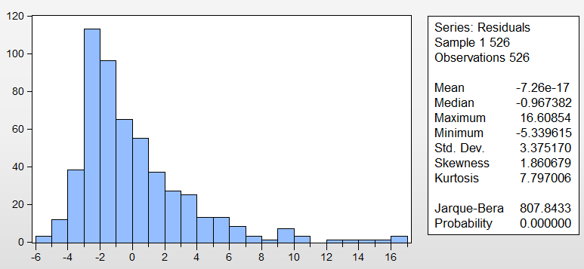
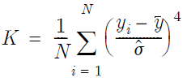

Example 2.4: Wage and Education
Notes:
Enter page 375 in the pdf file Users Guide I, read “Histogram and Stats” for more details

Slide 18



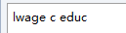
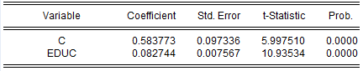
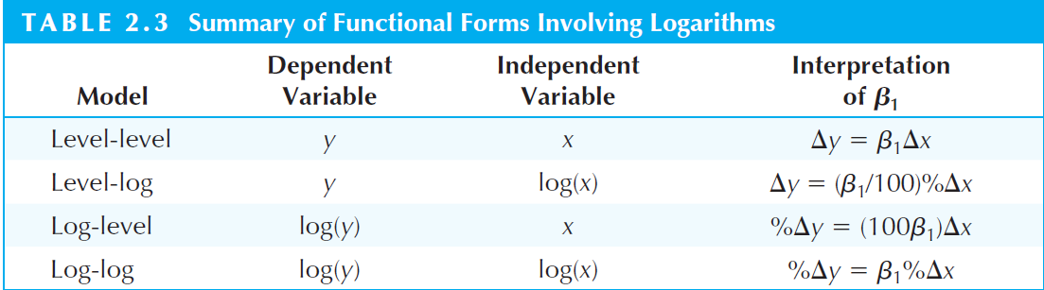
Example 2.10: A Log Wage Equation
Notes:
See Page 41 in Introductory Econometrics: A Modern Approach (5th edition) for more details

Slide 19
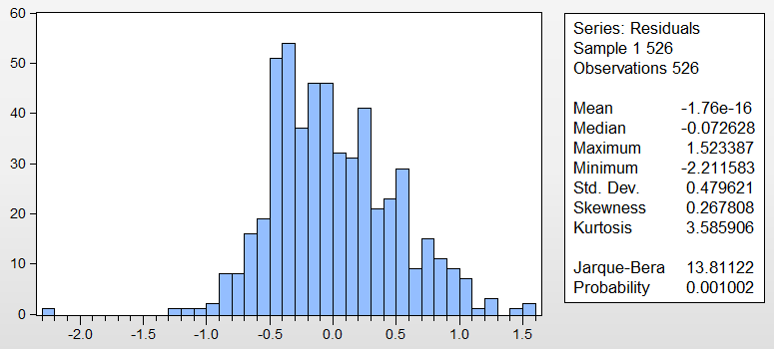
Example 2.10: A Log Wage Equation
The residuals from the log(wage) regression appear to be more normally distributed. The histogram for the wage residuals is notably skewed to the left. In the wage regression there are some very large residuals (roughly equal to 16) that lie almost four estimated standard deviations ( = 3.375170) from the mean of the residuals, which is identically zero, of course. Residuals far from zero does not appear to be nearly as much of a problem in the log(wage) regression.

Slide 20
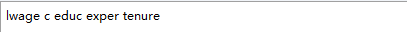
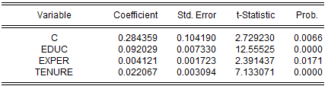
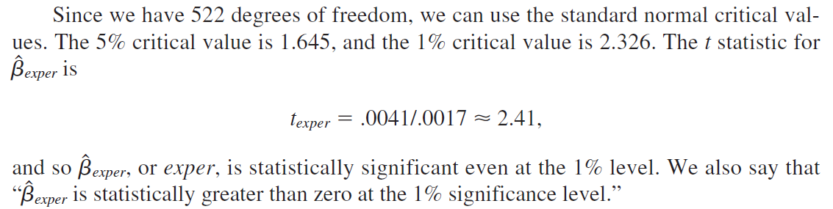
Example 4.1: Hourly Wage Equation
Notes:
See Page 122 in Introductory Econometrics: A Modern Approach (5th edition) for more details

Slide 21


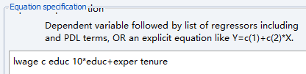

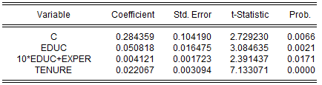
Example 4.1: Hourly Wage Equation with linear restriction
Let
Then
H₀ :

Slide 22
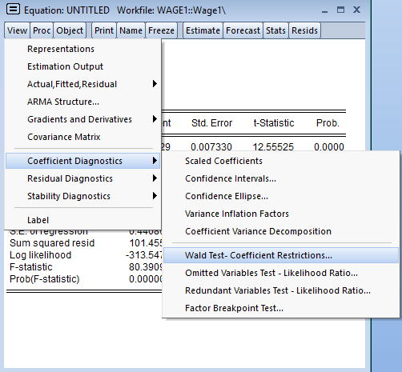
Example 4.1: Hourly Wage Equation with nonlinear restriction
Wald Test
To test restrictions on coefficients, choose View/Coefficient Diagnostics/Wald-Coefficient Regressions… from the equation toolbar. Enter the restrictions into the edit box, with multiple coefficients separated by commas. The coefficients should be referred to as C(1), C(2), and so on.
Notes:
Enter page 163 in the pdf file in Users Guide II “Wald Test (Coefficient Restrictions)” for more details

Slide 23
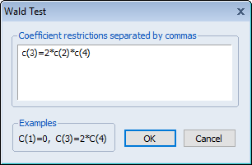
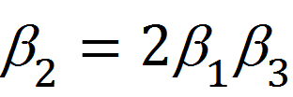
Example 4.1: Hourly Wage Equation with nonlinear restriction
Using Wald Test for nonlinear restriction
H₀ :

Slide 24
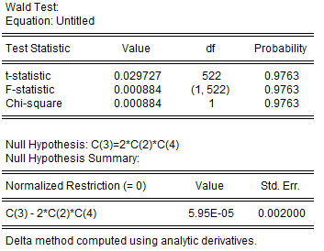
Example 4.1: Hourly Wage Equation with nonlinear restriction
EViews reports an F-statistic and a Chi-square statistic with associated p-values. In cases with a single equation, EViews reports the t-statistic equivalent of the F-statistic. In addition, EViews reports the value of the normalized (homogeneous) restriction and an associated standard error.
Notes:
Enter page 168 in the pdf file in Users Guide II “Wald Test Details” for more details; Enter page 163 in the pdf file in Users Guide II “Wald Test (Coefficient Restrictions)” for more details

